Slide 1
Web Accessibility

Slide 2
What is Web Accessibility
Web accessibility means making your website available to as many people as possible.
This includes people with all forms of disabilities including the following:
Cognitive - dyslexia, autism, ADHD
Neurological
Physical - not having the use of certain limbs and paralysis
Speech - people who are not able to speak or who have a speech impediment
Visual - blindness, low-vision, color blind
auditory disabilities - deaf and hard of hearing

Slide 3
Who defines web accessibility
W3C’s Web Accessibility Initiative (WAI) develops technical specifications, techniques, guidelines and resources to help individuals, businesses and organizations make digital properties accessible. W3C’s Web Content Accessibility Guidelines (WCAG)are the most widely accepted accessibility standard. WCAG 2.0 is the version required for compliance with Section 508 of the Rehabilitation Act, the Accessibility for Ontarians with Disabilities Act (AODA) and other accessibility laws.
Why do you need an accessible website?
There are three key benefits of having an accessible website:
Your website will comply with your country’s equality law
You’ll save money by working in accessibility on your own terms
You’ll make more money by expanding your customer base

Slide 4
What is WCAG
WCAG, a.k.a. the Web Content Accessibility Guidelines, are the technical guidelines created by the World Wide Web Consortium (W3C) for creating accessible web-based content.
WCAG serves as the basis of accessibility regulations across the globe including the US, Canada, the UK, the EU, Australia, and Japan. In 2008 these guidelines were updated and dubbed WCAG 2.0. Here’s the least you need to know about WCAG 2.0:

Slide 5
Understanding of WCAG
WCAG encompasses Principles, Guidelines, Success Criteria, and Sufficient and Advisory Techniques.
WCAG Success Criteria are broken down into different “levels of conformance”:
A (basic conformance)
AA (intermediate conformance)
AAA (advanced).
Compliance with WCAG 2.0 A and AA success criteria generally serves as the default definition of “accessible” when it comes to web content.
The shorthand for the principles underlying WCAG 2.0 is “P.O.U.R.”: Perceivable, Operable, Understandable, Robust.
There are a lot of different ways to meet WCAG 2.0 success criteria. The W3C does provide techniques for meeting these criteria, but they’re only suggestions and won’t necessarily be a good fit for every variation of an accessibility issue.
Finally, WCAG 2.0 is ultimately about the user’s actual experience. If your user interface technically meets WCAG requirements but is inaccessible in practice, your UI is inaccessible.

Slide 6
The POUR principle
The POUR principle is what guides building accessible websites. This principle helps put people at the center of the process. Every website should fulfill the following principles:
Perceivable:Content on the web should be perceivable.
Operable:Content on the web must be operable.
Understandable:The content on the web should be clear and concise and easy to understand.
Robust:It is really important to have consistency across the web. What this means is are you maximizing compatibility with the tools you are building for? Does your site work the same way across all platforms i.e Browsers, Operating systems, and Device sizes etc?

Slide 7
Accessibility and the Law
Americans with disabilities act: This law states that all the domains like public buildings, schools and organizations should make the technology accessible to everyone.
Rehabilitation Act, section 504 and section 508: Section 504 accommodates all people with disabilities to access workplace, education & other organization and section 508 accommodates access to technology.
Web content accessibility guidelines: These guidelines suggest the ways that can help to improve the accessibility of a website.

Slide 8
Tools To Leverage When Building Accessible Sites
a11y.css
aXe
Chrome Vox
Contrast Checker
Voice Over
Wave
JAWS
NVDA

Slide 9
Tips For Making Your Site Accessible on the Web
Add Alternative Text for Images:
Make use of Semantic HTML:
Always provide an option to skip the Main Content:
Identify page language and language changes:
Associate a label with every form element:
Understanding the heading hierarchy
Defining the role for each and every region of the page. Ex: banner, header, main, footer, navigation.

Slide 10
HTML & Accessibility
A great deal of web content can be made accessible just by making sure the correct Hypertext Markup Language elements are used for the correct purpose at all times. As you learn more about HTML — read more resources, look at more examples, etc. — you'll keep seeing a common theme: the importance of using semantic HTML
Benefits of using semantic markup in accessibility:
Easier to develop with
Better on mobile
Good for SEO

Slide 11
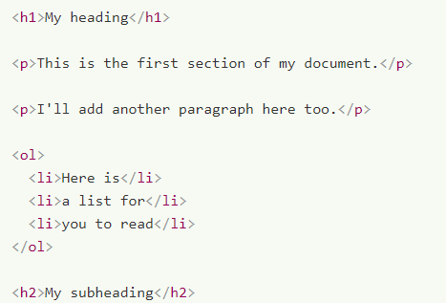
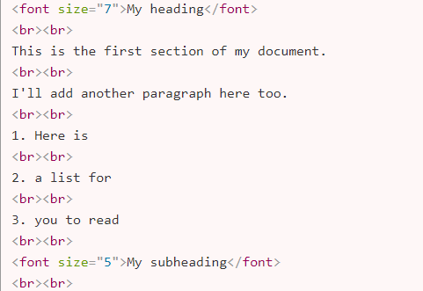
Good semantics
We've already talked about the importance of good semantics, and why we should use the right HTML element for the job. This cannot be ignored, as it is one of the main places that accessibility is badly broken if not handled properly.
Good Semantic Bad Semantic
The goal isn't "all or nothing", however — every improvement you are able to make will help the cause of accessibility.

Slide 12
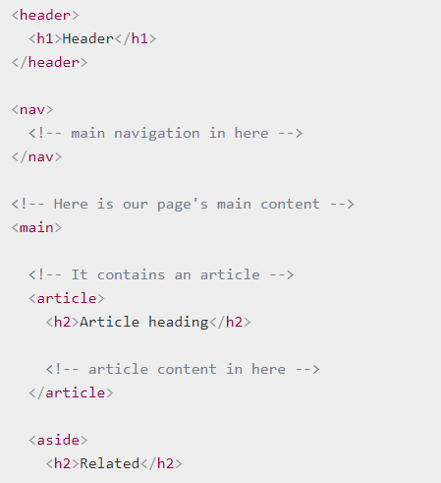
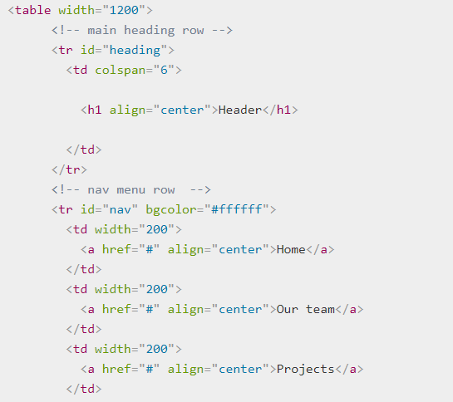
Page Layouts
People used to create page layouts using HTML tables — using different table cells to contain the header, footer, side bar, main content column, etc. This is not a good idea because a screen reader will likely give out confusing readouts, especially if the layout is complex and has many nested tables.
Note: Creating a layout with a nested div structure is not a good practice either.

Slide 13
Using clear language
In general you should use clear language that is not overly complex. This not only benefits people with cognitive or other disabilities; it benefits readers for whom the text is not written in their first language
Don't use dashes if you can avoid it. Instead of writing 5–7, write 5 to 7.
Expand abbreviations — instead of writing Jan, write January.
Expand acronyms, at least once or twice. Instead of writing HTML in the first instance, write Hypertext Markup Language.

Slide 14
Importance of HTML5
UI Controls:
The main parts of web documents that users interact with — most commonly buttons, links, and form controls.
Building keyboard accessibility back in
Meaningful text labels
Text Alternatives
Whereas textual content is inherently accessible, the same cannot necessarily be said for multimedia content — image/video content cannot be seen by visually-impaired people, and audio content cannot be heard by hearing-impaired people.
Empty Alt Attributes
More on Links
External Links
Skip Links

Slide 15
Semantics
For understanding the semantics in a detailed way follow the below link:
http://html5doctor.com/
Semantics which are must use for your application in terms of accessibility:
Doctype, HTML, Head, Title, style, script,
Body, article, nav, aside, section, header, footer, main, <h1 – H6>
P, Hr, Ol, ul, li, div, figure
Form fieldset, legend etc etc

Slide 16
ARIA Attributes
What is the full form of ARIA?
Accessible Rich Internet Applications
What is ARIA?
Set of attributes that define ways to make web content and web applications (especially those developed with JavaScript) more accessible to people with disabilities.
WAI-ARIA is a specification written by the W3C, defining a set of additional HTML attributes that can be applied to elements to provide additional semantics and improve accessibility wherever it is lacking.
There are three main features defined in the spec:
Roles
Properties
States
Your operating system needs to run browsers that have the necessary accessibility APIs in place. global browser support for WAI-ARIA was around 88%.

Slide 17
When you Should Use WAI-ARIA
There are four main areas that WAI-ARIA is useful in:
Signposts/Landmarks: ARIA's role attribute values can act as landmarks that either replicate the semantics of HTML5 elements (e.g. <nav>), or go beyond HTML5 semantics to provide signposts to different functional areas, e.g search, tabgroup, tab, listbox, etc.
Dynamic content updates: Screenreaders tend to have difficulty with reporting constantly changing content; with ARIA we can use aria-live to inform screenreader users when an area of content is updated
keyboard accessibility: when other elements are used along with JavaScript to simulate similar interactions, keyboard accessibility and screenreader reporting suffers as a result. Where this is unavoidable, WAI-ARIA provides a means to allow other elements to receive focus (using tabindex).
Accessibility of non-semantic controls: When a series of nested <div>s along with CSS/JavaScript is used to create a complex UI-feature, or a native control is greatly enhanced/changed via JavaScript, accessibility can suffer — screenreader users will find it difficult to work out what the feature does if there are no semantics or other clues. In these situations, ARIA can help to provide what's missing with a combination of roles like button, listbox, or tabgroup

Slide 18
Thank You.

